Slide 1
Ensemble Methods - Random Forests
a bold adventure

Slide 2
Problem - Decision trees overfit
Review: what does it mean for decision trees to overfit? What does it mean in terms of bias and variance?
As we saw yesterday, can deal with it through pre-pruning and post-pruning
But much more common: ensemble methods

Slide 3
Ensemble Methods
Big idea: as we average, variance goes down
Recall from yesterday: the variance of a single decision tree is high
If we take the average of a lot of high-variance models, the variance of the total “ensemble model” goes down
Combine a lot of “weak learners” to create a “strong learner”

Slide 4
How do we create and combine “a lot of weak learners”?
Goal: want to create lots of decision trees and combine their results
Problem: only a finite amount of data in our dataset
Mitigation: Bootstrap AGGregatING

Slide 5
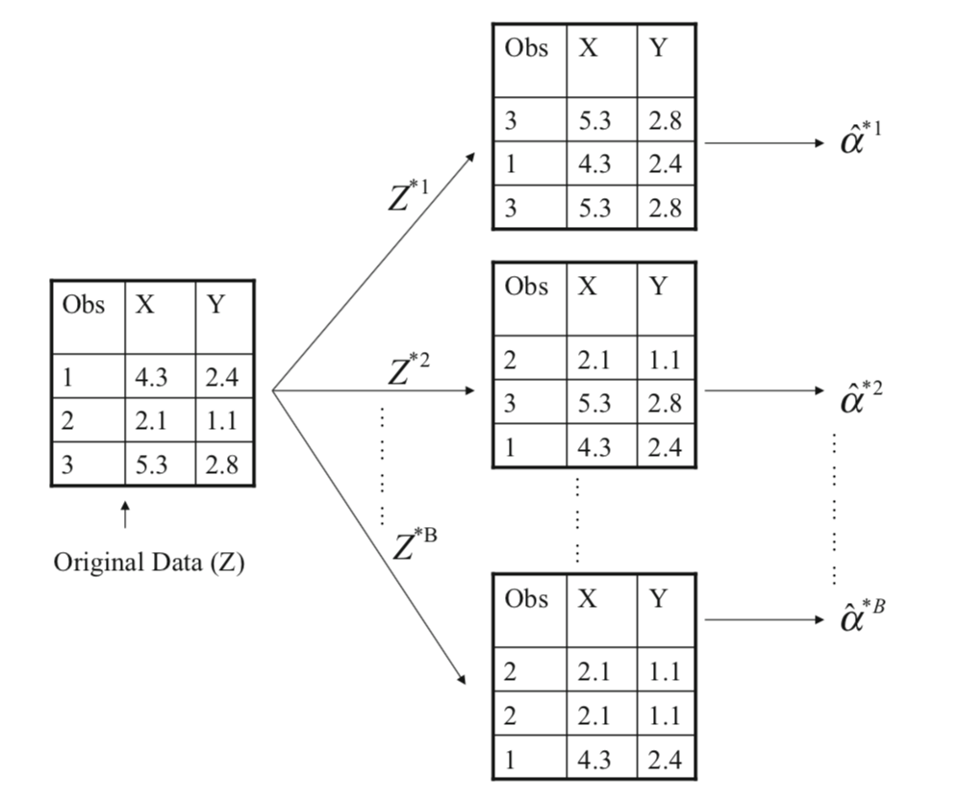
Bootstrap AGGregatING
Bootstrap: repeatedly sample the data, with replacement, and generate models using each sampled dataset
Aggregating: combining the predictions of those models

Slide 6
Bootstrap AGGregatING
Trees made from boosted data:
Usually grown fully, not pruned (high-variance trees)
How are models aggregated? Run each obs through each tree
For classification, final prediction is ‘majority vote’ of predicted class
For regression, final prediction is avg of predicted value

Slide 7
Bootstrap AGGregatING
Concept check:
What problem is Bootstrap AGGregatING designed to mitigate, and how does it do so?
What hyperparameters do bagged trees have that decision trees don’t?

Slide 8
Bootstrap AGGregatING
Out of Bag (OOB) data
Since we re-sample to create bagged trees, not all the data is going to be used for each bagged tree
Data that is not used to construct a bagged tree is “out of bag” data
We can use that “out of bag” data as a kind of test set!
Grow our trees, then run “out of bag” data - which the trees haven’t seen - through them to generate predictions

Slide 9
Bootstrap AGGregatING
Out of Bag (OOB) data
Since we re-sample to create bagged trees, not all the data is going to be used for each bagged tree
Data that is not used to construct a bagged tree is “out of bag” data
We can use that “out of bag” data as a kind of test set!
Grow our trees, then run “out of bag” data - which the trees haven’t seen - through them to generate predictions

Slide 10
Bootstrap AGGregatING
Variable importance
Problem: since we’re aggregating trees, we don’t have one nice decision tree that represents how our model splits data into leaf nodes
It’s harder to interpret how our model is generating predictions
Mitigation: across all bagged trees, average the information gain a given feature provides when it’s used in a split

Slide 11
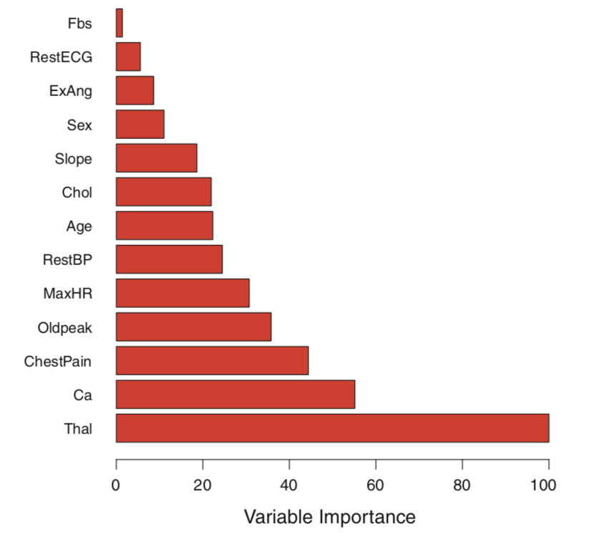
Bootstrap AGGregatING
From Intro to Statistical Learning in R, pg 320

Slide 12
Bootstrap AGGregatING
You’re going to be tempted to treat these numbers as coefficients
From Intro to Statistical Learning in R, pg 320

Slide 13
Bootstrap AGGregatING
Don’t!
From Intro to Statistical Learning in R, pg 320

Slide 14
Bootstrap AGGregatING
Keep in mind what they are: averaged information gain when a feature is used in a split. Different interp.
From Intro to Statistical Learning in R, pg 320

Slide 15
Bootstrap AGGregatING
Concept check: is OOB data used to construct these feature importances?
From Intro to Statistical Learning in R, pg 320

Slide 16
Bootstrap AGGregatING
Problem: on average, each bagged tree is going to use these features in a similar way
From Intro to Statistical Learning in R, pg 320

Slide 17
Bootstrap AGGregatING
Problem: on average, each bagged tree is going to use this feature in the first split
From Intro to Statistical Learning in R, pg 320

Slide 18
Bootstrap AGGregatING
Problem: on average, each bagged tree is going to use this feature in the second split, etc.
From Intro to Statistical Learning in R, pg 320

Slide 19
Bootstrap AGGregatING
Problem: so, on average, our bagged trees are going to all look the same - ie, their predictions will be correlated - and we’ll have a tendency to overfit. (Why?)
From Intro to Statistical Learning in R, pg 320

Slide 20
Bootstrap AGGregatING
Mitigation:
From Intro to Statistical Learning in R, pg 320

Slide 21
Random Forests

Slide 22
Random Forests
Grow Bootstrap AGGregatED trees, but de-correlate them

Slide 23
Random Forests
Grow Bootstrap AGGregatED trees, but de-correlate them
For each tree, at each new split, allow the tree to only consider a subset of features to make the split on

Slide 24
Random Forests
Grow Bootstrap AGGregatED trees, but de-correlate them
For each tree, at each new split, allow the tree to only consider a subset of features to make the split on
In other words: at each split, take a random sample from the names of features. This random sample of feature names is what the tree is allowed to consider to split on

Slide 25
Random Forests
Grow Bootstrap AGGregatED trees, but de-correlate them
For each tree, at each new split, allow the tree to only consider a subset of features to make the split on
In other words: at each split, take a random sample from the names of features. This random sample of feature names is what the tree is allowed to consider to split on
Split 1: [‘salary’, ‘age’, ‘gender’, ‘income’]
Split 2: [‘income’, ‘race’, ‘age’, ‘education’]

Slide 26
Random Forests
So, a random forest is:
a collection of trees
made through Bootstrap AGGregatING
that are only allowed to consider a subset of features at each split
What hyperparameters do random forests have that bagged trees don’t?

Slide 27
Random Forests
Another layer of de-correlation sometimes used:
Instead of an optimal split, bagged trees can be grown using random splits
Think of this as randomly sampling the splits that can be made. If we randomly sample enough times, the relationships in the data will reveal themselves in the averages
Can be used on bagged trees or random forests
In practice: not often an improvement on RF, but worth trying

Slide 28
Random Forests
Concept check: how do we categorize the random forests algorithm?

Slide 29
Random Forests
Pros and Cons
Powerful - random forests are used everywhere
Relatively fast compared to other standard algos
Useful measure of feature importance
Hard to explain / interpret
Grid-searching hyperparameters increases computation time

Slide 30
Random Forests
Concept take-aways:
In terms of bias-variance tradeoff, decision trees are extremely variable
Mitigate that with ensemble methods - averaging a lot of “weak learning” models together to get a “strong model”
Bagging re-samples the data to generate each tree, and aggregates their predictions together -> decrease variance
Bagged trees are correlated - they tend to make the same predictions, which interferes with variance decrease
Mitigate that with random forests - only allow a subset of features to be considered at each split

